Slide 1



CAPSTONE PROJECT
Analyzing Agriculture Productivity Across Indian States
Presented By:-
Student Name: KRISHNA SHIVAJI DHALE
College Name: SINHGAD COLLEGE OF ENGINEERING
Department: BE-CSE
Email ID: krishnadhale2@gmail.com

Slide 2
OUTLINE:
Problem Statement
Proposed System/Solution
System Development Approach
Result
Conclusion
Future Scope
References

Slide 3
Problem Statement:
India is land of farmers so to help them we have to gather large and complex Agricultural data such as crop production and fertilizer usage . This data is difficult to analyze using traditional methods. There is a need for an interactive system that can visualize agricultural productivity trends and help day to day farmers and organization which works on farmers issue to make informed decisions. This project uses Power BI dashboards to analyze and visualize agricultural productivity data effectively.

Slide 4
Proposed Solution:
The proposed solution uses Power BI dashboards to analyze agricultural productivity data. The system collects and processes data related to crop production and fertilizer usage, then visualizes it through interactive charts and graphs. This enables users to easily identify trends, compare productivity across regions and years, and make better decisions to improve agricultural performance.
Data Collection:
Collected agricultural data from Kaggle public dataset
Dataset includes Crop, Crop Year , Season , State , Area , Production Rate ,Annual rainfall, Fertilizer , pesticide , Yield imported into power Bi.
Data Preprocessing:
For data we have only taken year and removed date and month column . taken Area as whole number. Taken state name in upper case.
Removed farmer name column which is not required.
Filled annual rainfall missing value by taking mean.
Charts used:
Sheet1:-Overview (1)stacked bar chart (2)pie chart
Sheet2:-Fertilizer (1)Line and stacked column chart (2)Scatter chart
Sheet3:-Production (1)Table chart (2)Donut chart (3)key influencers chart
Deployment:
To Develop a user-friendly interface that provides real-time predictions for Analyzing Agriculture Productivity Across Indian States.
Deploy the solution on a scalable and reliable platform, considering factors like server infrastructure, response time, and user accessibility.
Evaluation:
Assess the Power BI model's performance by checking if data is accurate or not, always check for newer data set and that info in your dataset.
Fine-tune the power bi model based on farmers and organization feedback and always continuous monitoring for better prediction and accuracy.

Slide 5
System Approach: 1. Data Import – Loaded agricultural dataset into Power BI. 1)Collected agricultural data from Kaggle public dataset 2)Dataset includes Crop, Crop Year , Season , State , Area , Production Rate ,Annual rainfall, Fertilizer , pesticide , Yield imported into power Bi 2. Visualization – Created charts for crop productivity, regional yield comparison. (1)overview sheet:- (1)It includes Average of annual rainfall, Average of Fertilization, Average of Production it also includes (2)stacked bar chart shows average of production in X-axis and Crop in Y-axis (3)also include pie chart which shows average of production by state. Which include state column. (2)Fertilizer sheet:- 1) it includes average of production and average of Fertilizer by crop which is shown by Line and stacked column chart 2)second chart is of sum of Fertilizer and sum of crops shown by scatter chart with respect to state and season . (3) Energy Consumption Trend Analysis:- 1)It includes energy consumption and trend analysis which includes normal table which has column like state ,season crop, sum of area , sum of annual rainfall , sum of pesticide, sum of Fertilizer, sum of production 2)it also include dount chart which shows values such as sum of production 3) third chart shows key influencers which analyze Fertilizer and Explain sum of production. 3. Dashboard – Designed a report with slicers and KPIs. By this way system approach goes.

Slide 6
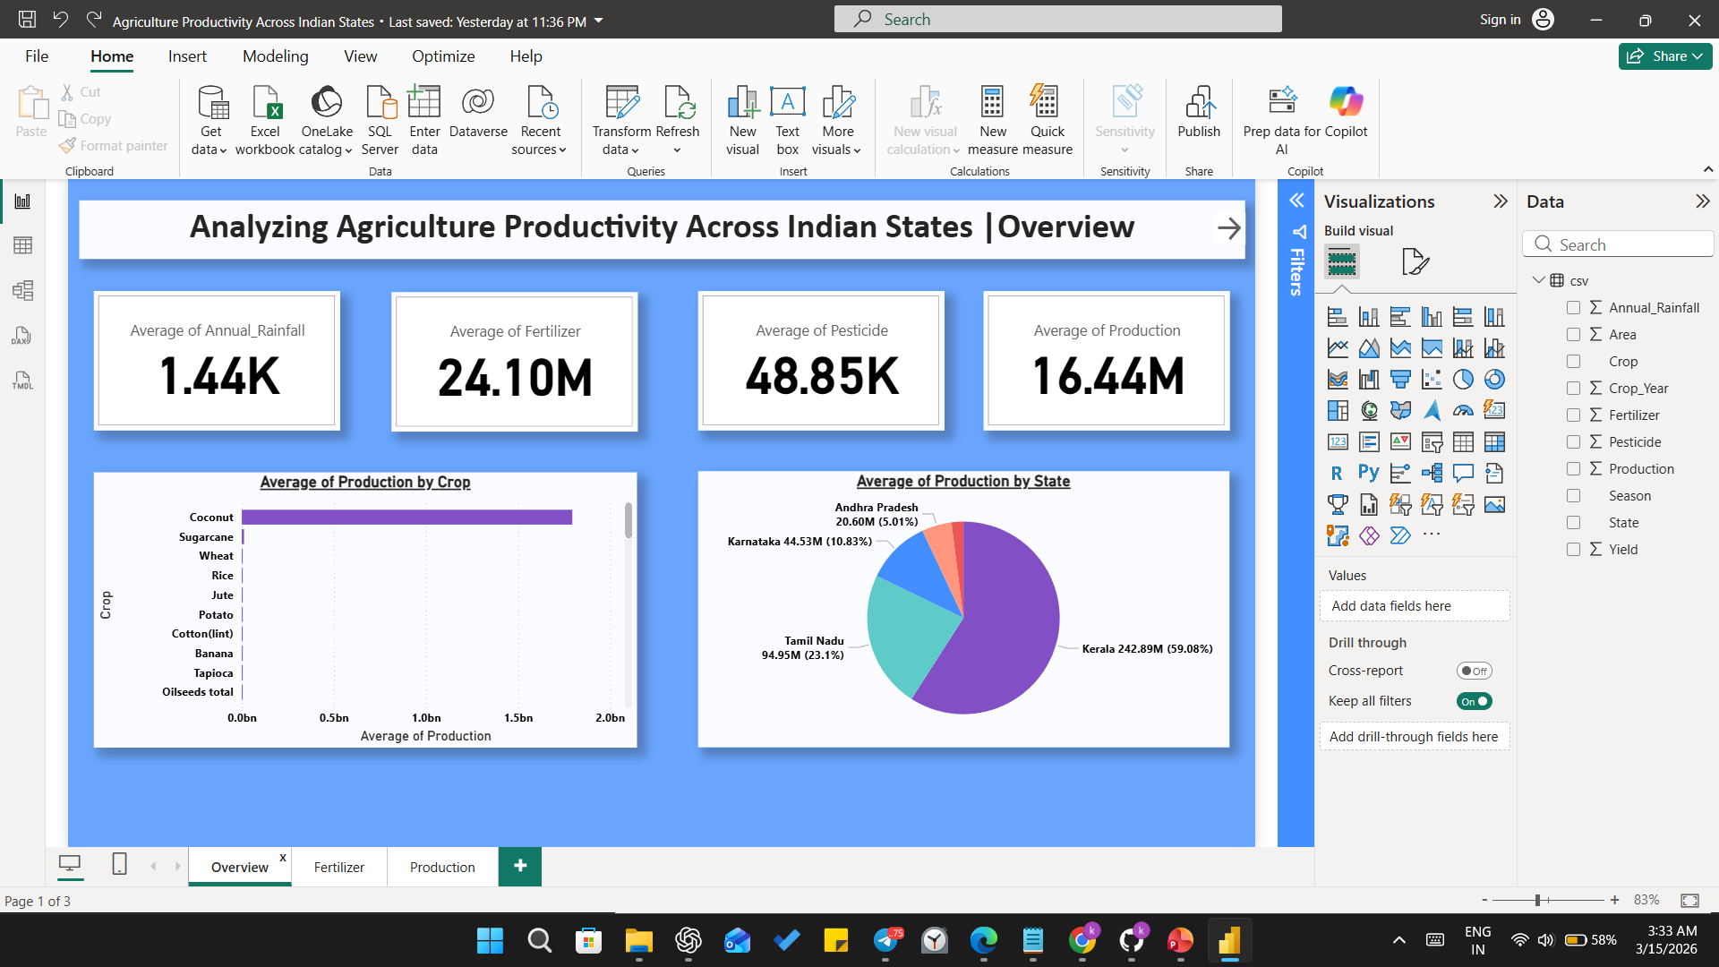
Result: Screenshot of output:-

Slide 7
Conclusion:
The project demonstrates the power of visualization tools like Power BI in transforming raw agricultural data into meaningful insights. It supports better planning and decision-making in the agricultural sector by identifying trends, inefficiencies, and opportunities.

Slide 8
Future scope:
In the future, this project can be enhanced by integrating real-time agricultural data to provide more accurate and up-to-date insights. Advanced technologies such as machine learning can be used to predict crop production and productivity trends. Additional factors like weather conditions, soil quality, and irrigation data can also be included to improve the analysis. Furthermore, the dashboard can be developed as a mobile or web-based application so that farmers, researchers, and policymakers can easily access the information and make better decisions.

Slide 9
References:
To build this reference taken from session conducted by edunet foundation
Dataset is taken from Kaggle public dataset platform below link is provided for that
https://www.kaggle.com/datasets/thammuio/all-agriculture-related-datasets-for-india?resource=download
All the Project and dataset information is present in below mentioned github profile link
GitHub Link: https://github.com/KrishnaDhale/Analyzing-Agriculture-Productivity-Across-Indian-States.git

Slide 10
Thank You

